Slide 1
Activity diagram and use case diagram submitted by- gurpreet singh

Slide 2
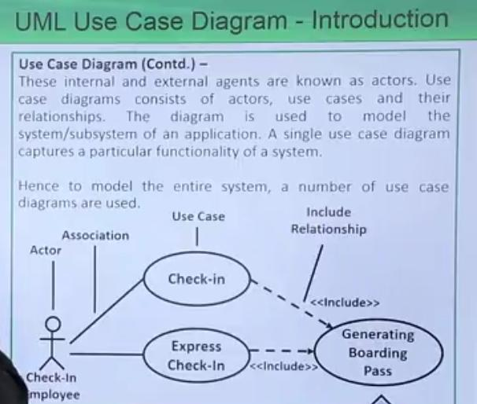
USE CASE Diagram - introduction

Slide 3
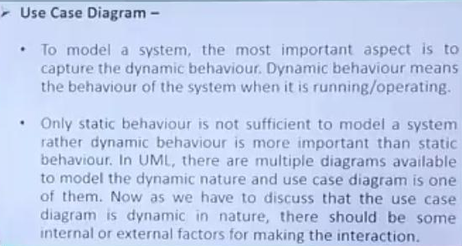
Continue….

Slide 4
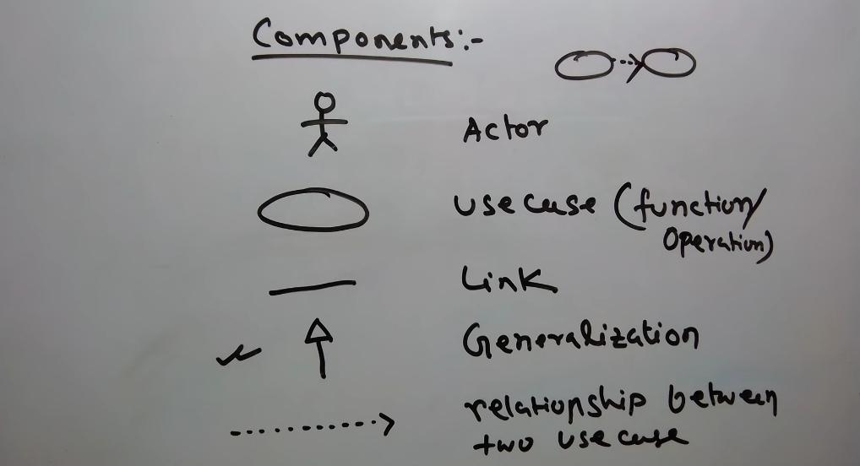
example

Slide 5
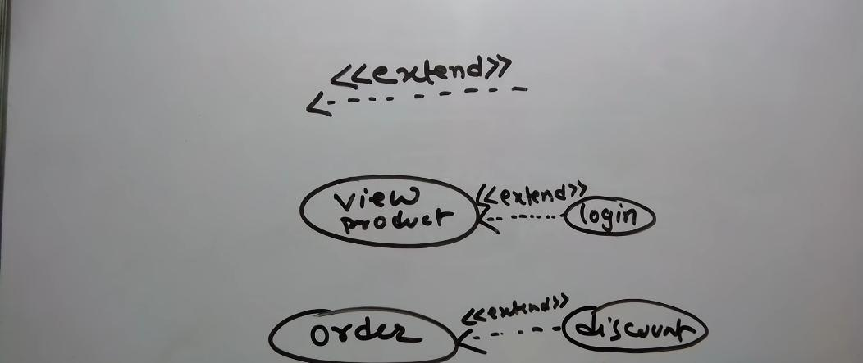
example

Slide 6
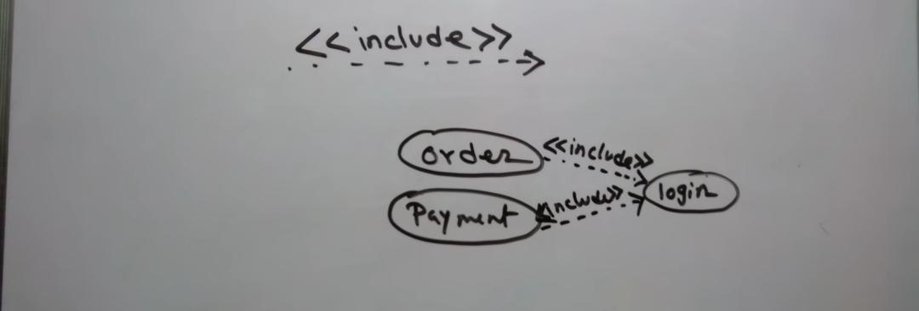
example

Slide 7
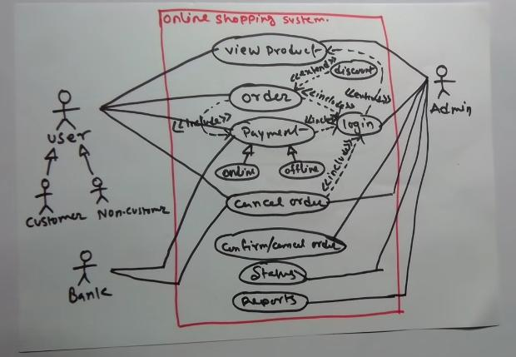
example

Slide 8
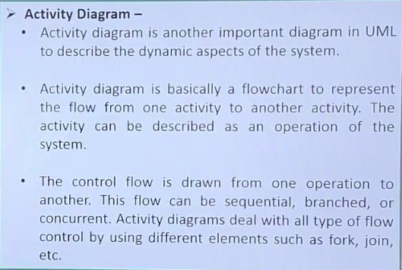
UML ACTIVITY DIAGRAM - Introduction

Slide 9
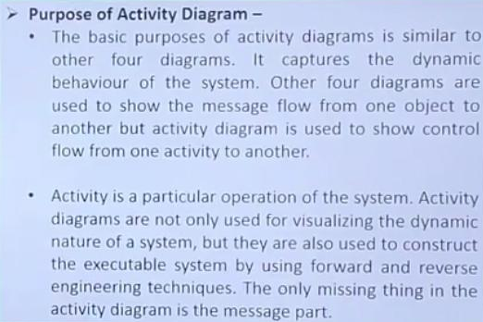
Purpose of activity diagram

Slide 10
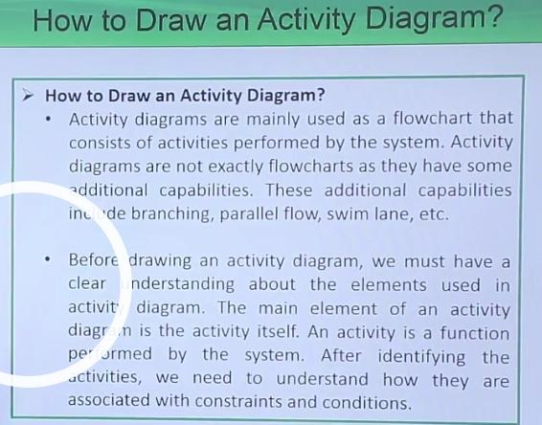
How to draw an activity diagram?

Slide 11
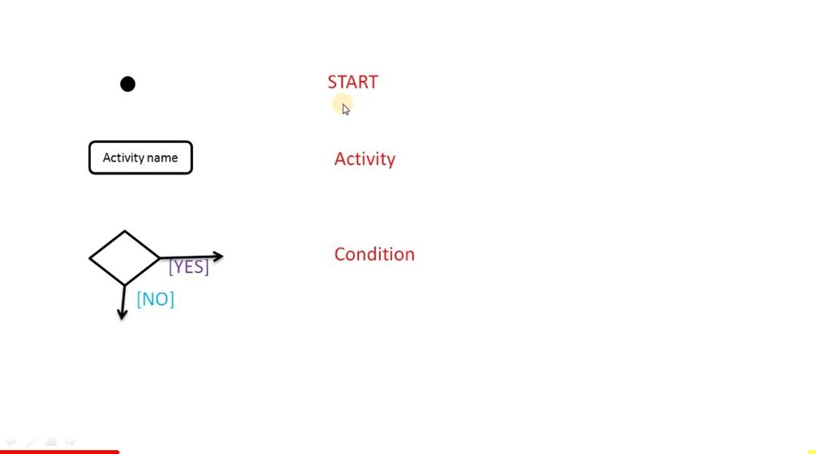
notations

Slide 12
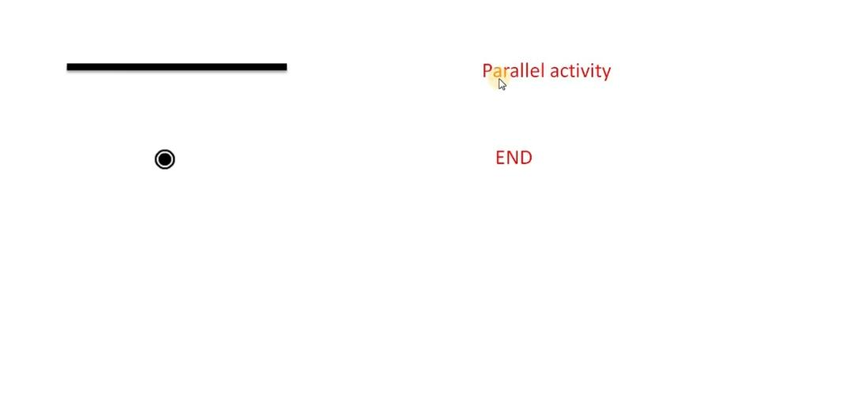
notations

Slide 13
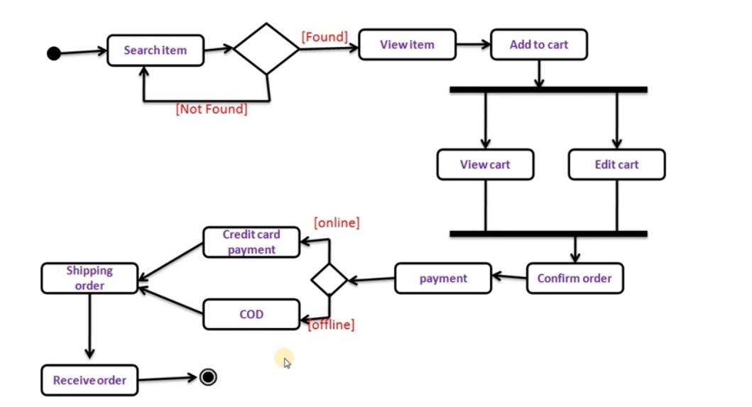
example

Slide 14
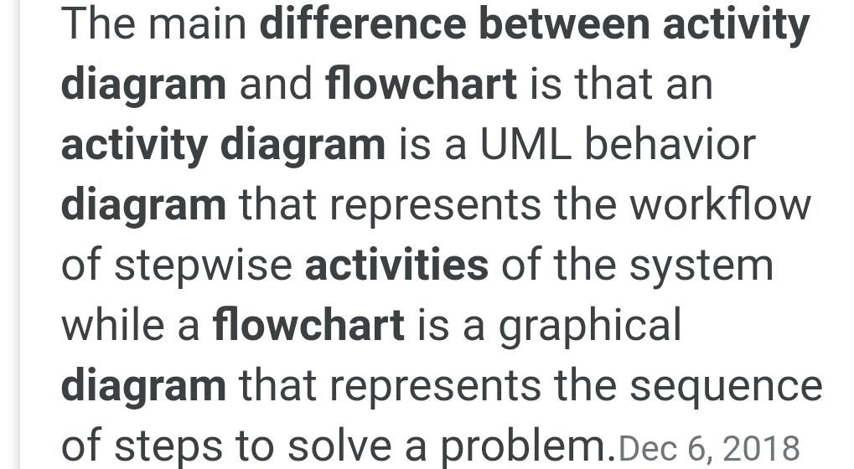
Difference between activity diagram and flowchart

Slide 15
